Slide 1
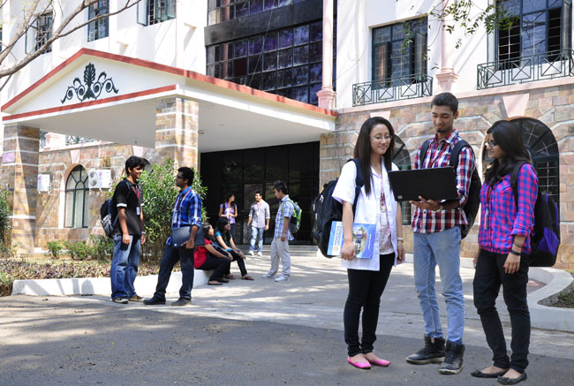

B.Tech Computer Science and Engineering – Vth Semester
Theory of Computation
Department of Computer Science and Engineering

Slide 2
A CFG which generates Palindromes
P->ε
P->0
P->1
P-> 0P0
P->1P1
The {V,T,P,S}
Gpal = ({P},{0,1},P,P)
L={0,1,000,111,010,101,10101,…}
Is an infinite set

Slide 3
A CFG for arithmetic expressions
G=(V,T,P,S)
G=({E,I},{+,*,(,),a,b,0,1},P,E)
{ab,a0,b0,aba01a}
{ab+bc}
{internal+external}
E->I
E->E+E
E->E*E
E->(E)
I->a
I->b
I->Ia
I->Ib
I->I0
I->I1

Slide 4
Left Most Derivation
The process of replacing always the left most Non Terminal(variable) is called as left most derivation.
Ex: E->E+I
Now we have two options to replace E and I. if we replace the left most non terminal(variable) i.e E here , then it is left most derivation.

Slide 5
Right Most Derivation
The process of replacing always the Right most Non Terminal(variable) is called as Right most derivation.
Ex: E->E+I
Now we have two options to replace E and I. if we replace the Right most non terminal(variable) i.e I here , then it is Right most derivation.

Slide 6
Sentential forms
Every string that appears on right side during the derivation process is called as a sentential form.
During left most derivation we can see left sentential forms.
During right most derivation we can see right sentential forms.
Ex during derivation of the string a+b
E->E+E
->I+E
->a+E
->a+I
->a+b
All strings we see here on the right side is a sentential from(here left sentential form)
Ex:E+E;E+I;a+E;a+I;a+b

Slide 7
Parse Trees
A tree like pictorial representation of any derivation is called as parse tree.
The parse will vary for every derivation.
Parse tree will be same for both left most derivation and right most derivation.

Slide 8
Thank You

